Slide 1


S&T ___________
01
OSC-Open Source Community
Powered by:
mahmoud mohamed

Slide 2

Who???
Notes:
Talk about names doesn’t matter no one under estimate of him self and me and each one of vices introduce him self

Slide 3

Your turn

Slide 4

Big family

Slide 5

Notes:
Are your ready

Slide 6


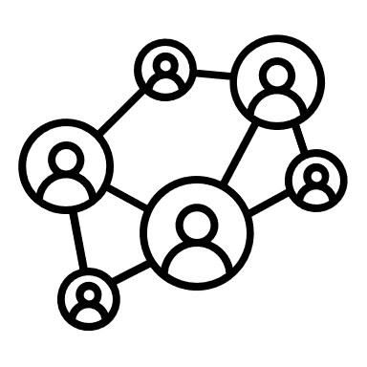

DS
DB
API’S
Tools
content
Notes:
Talk about what they are going to learn

Slide 7
Tools

Slide 8




Tools
Git + Git Hub
Vs code
CV
Linked in

Slide 9
Data Structures
PS
Data Base
EF
API’S
MVC
Notes:
Next session will talk about DS

Slide 10
Agenda ___________________________________
Git History
Why Git
The Basic workflow of Git
Git Common Commands
GitHub
Hands On

Slide 11
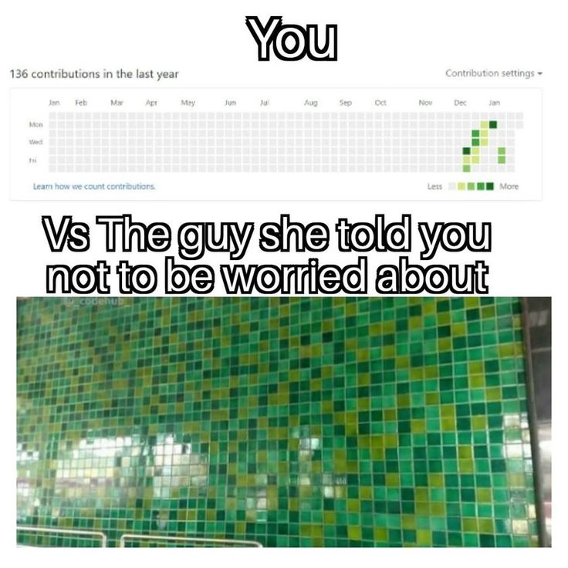
Let’s Go

Slide 12
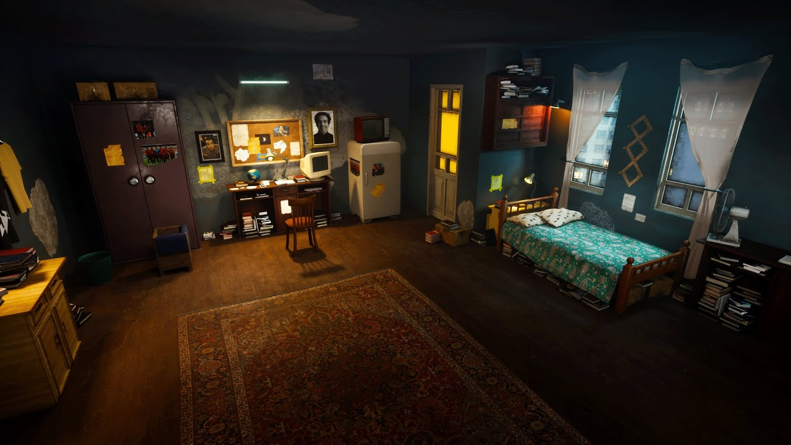


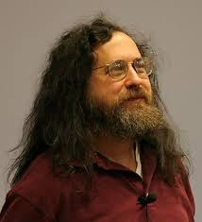
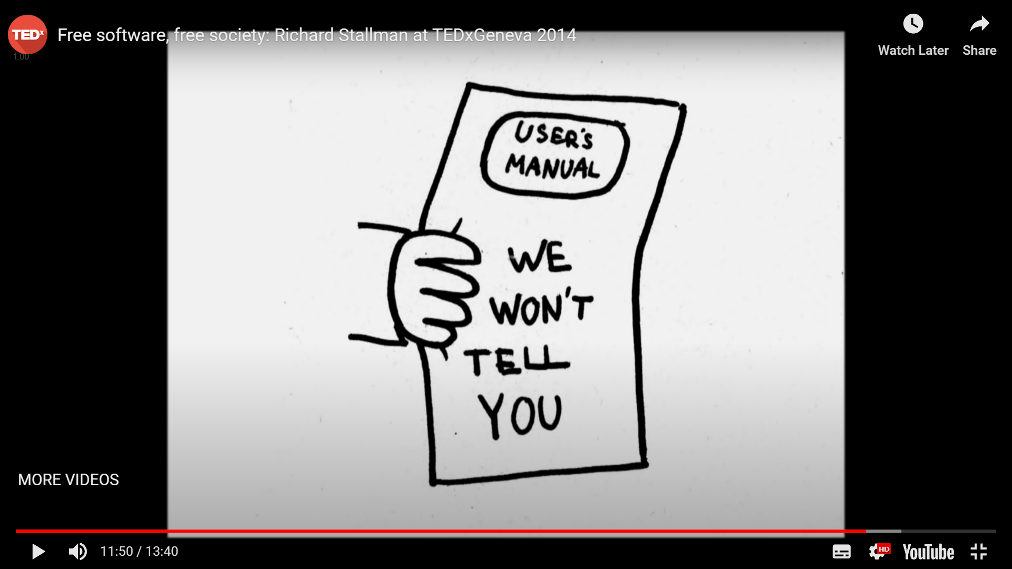
1953
1983
Richard Stallman

Slide 13


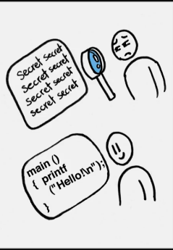

Importance of Open Source ___________________________________
Contribute & enhance
your resume
No malicious code
Freedom
Learning
Don’t reinvent the wheel wheel

Slide 14

OSS Examples ___________________________________
Notes:
Wordpress , inkscpace,cakephp(MVC php), gowls is ruby, Joomla is cololforl,fox is gimp,magento , Plugins flyy

Slide 15
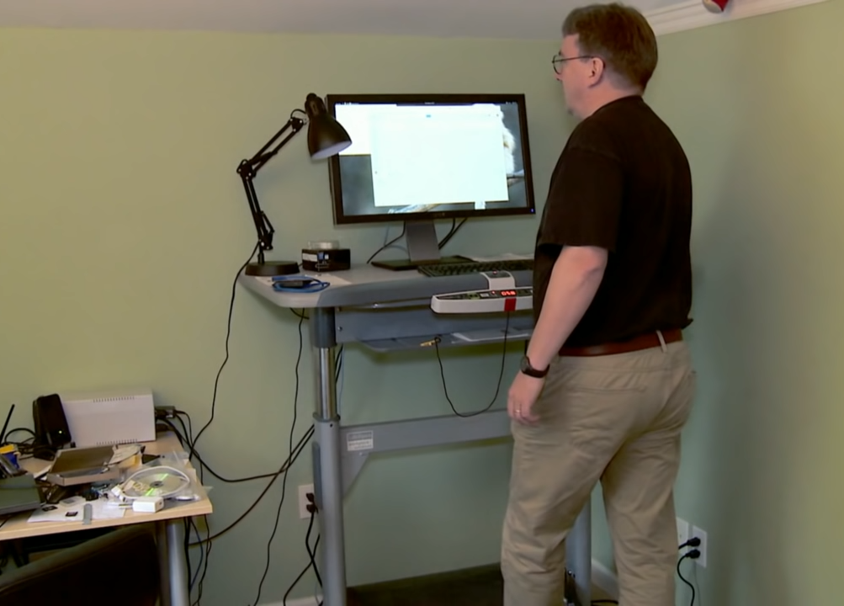

Slide 16



1969
2002
1992
2005
21 Linux
10
Linus Torvalds

Slide 17
Version Control Overview

Slide 18
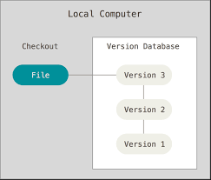
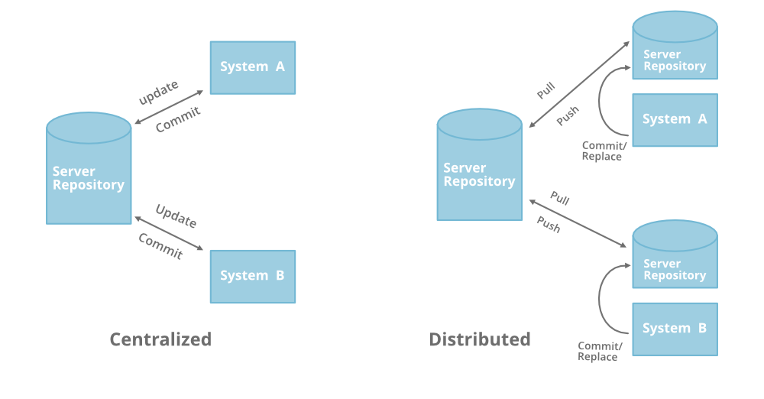
Version Control Systems 1975 ___________________________________
local
Notes:
d7i7

Slide 19

Jerk: contemptible or foolish person

Slide 20
What is Git? ___________________________________
Git is a free and open-source distributed version control system designed to handle everything from small to very large projects with speed and efficiency.
Git was created by Linus Torvalds in 2005 for development of the Linux kernel, with other kernel developers contributing to its initial development.

Slide 21

Why Learn Git? ___________________________________
Tracking code changes
Tracking who made changes
Coding collaboration
Snapshots Not Differences
Speed
Simple design
And it's not limited to just that, it can do more.

Slide 22
Why Learn Git? ___________________________________
Tracking code changes
Tracking who made changes
Coding collaboration
Snapshots Not Differences
Speed
Simple design
And it's not limited to just that, it can do more.

Slide 23
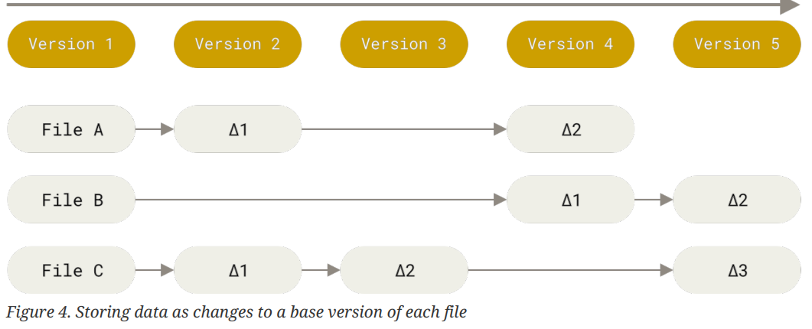
Incremental VCS

Slide 24
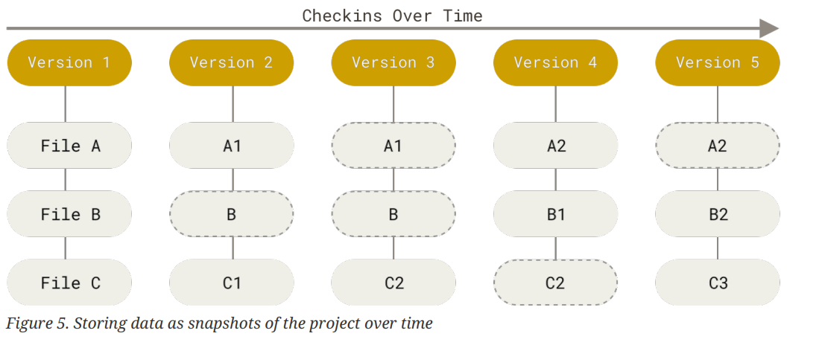
snapshots VCS

Slide 25
What we need in Git??!!
Track every thing
OS independent
Unique id
Track history

Slide 26
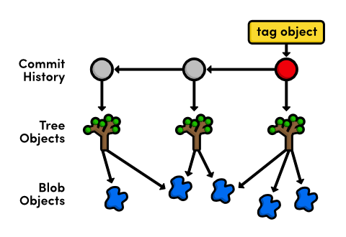


Track every thing
Track every thing
Git objects
(1) File becomes Blob why Blob contains content + meta data
(2) Folder becomes Tree why Tree contains content + meta data
(3) Commit Tagged Annotations

Slide 27
What we need in Git??!!
Track every thing
OS independent
Unique id
Track history

Slide 28


OS independent
OS independent
Add .git hidden folder to WD
.git

Slide 29
What we need in Git??!!
Track every thing
OS independent
Unique id
Track history

Slide 30
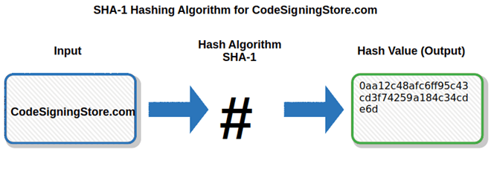
Unique id
Unique id
Make for each object Hashed value famous :- SHA-1
Not only content but we add[ {Blob || tree} size content null char ]
40 char
Notes:
Hash function

Slide 31
What we need in Git??!!
Track every thing
OS independent
Unique id
Track history

Slide 32
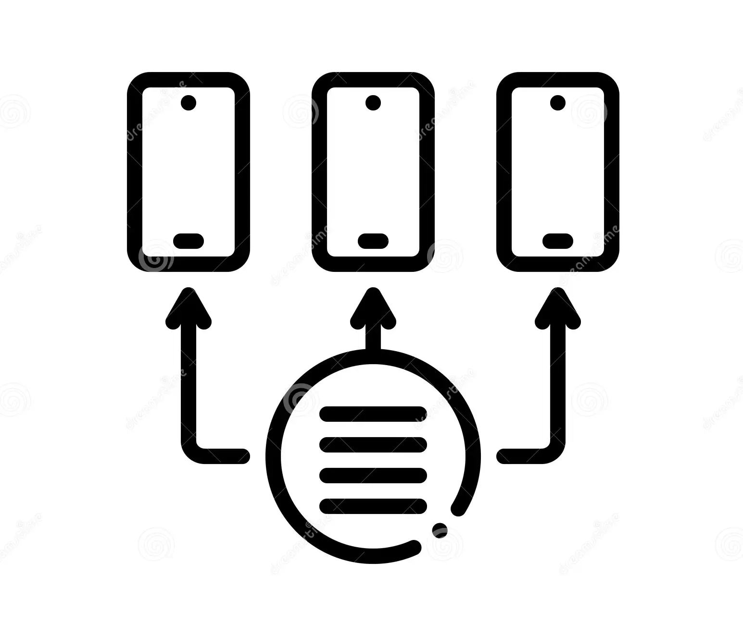
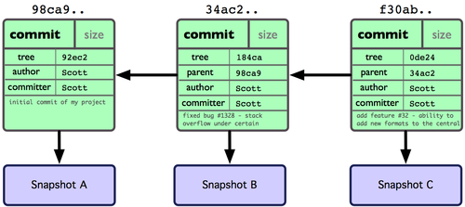
Track history
Track history
Compare between hash value to new file and old
Linked list

Slide 33
What we need in Git??!!
Track every thing
OS independent
Unique id
Track history

Slide 34
Architecture

Slide 35
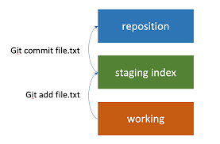
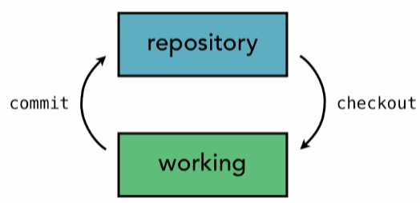
2 Tree
3 Tree

Slide 36
The Basic Workflow of Git

Slide 37
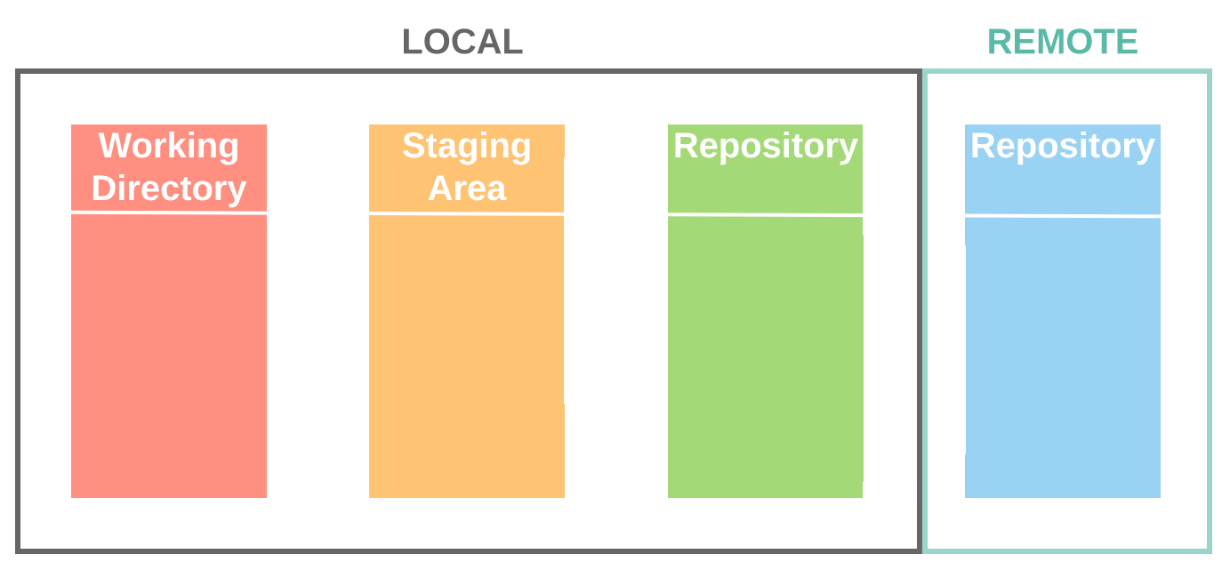

Slide 38
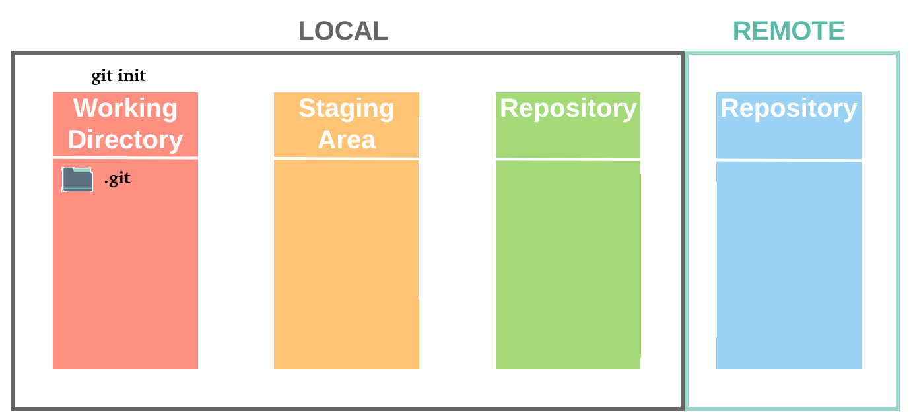

Slide 39
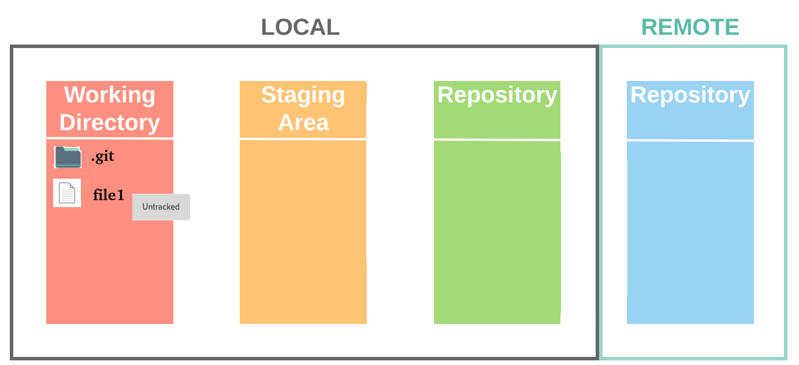

Slide 40
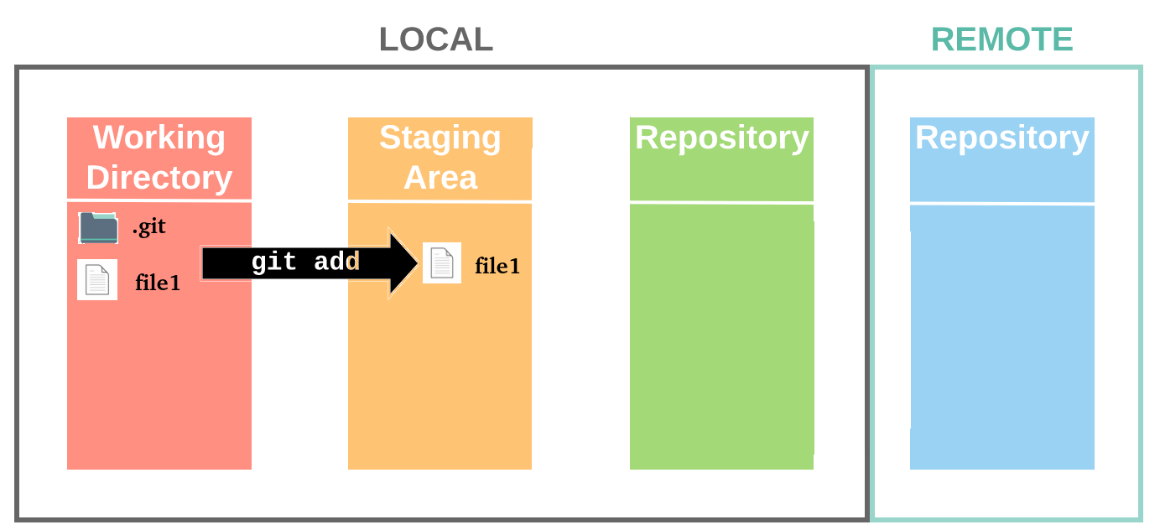

Slide 41
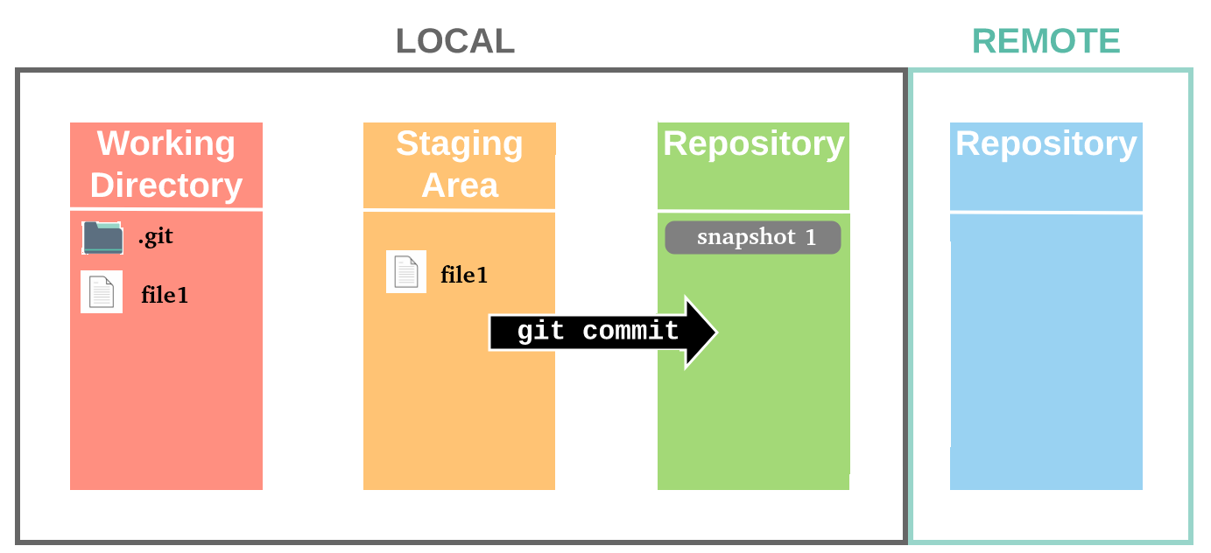

Slide 42
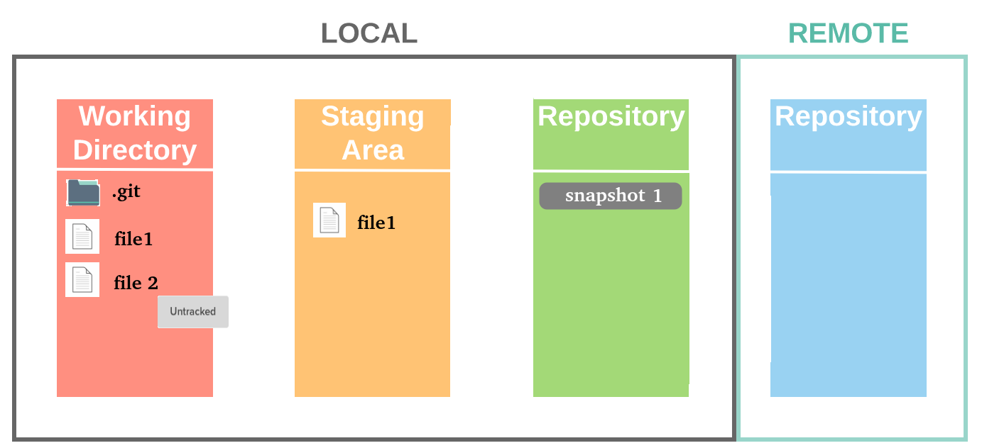

Slide 43
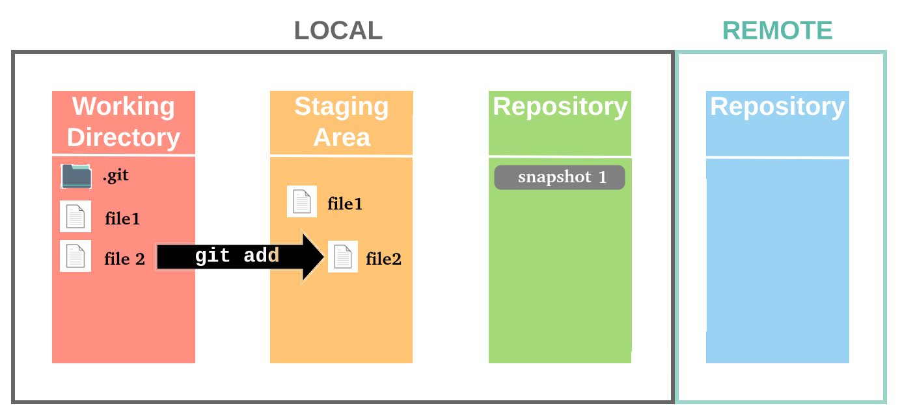

Slide 44
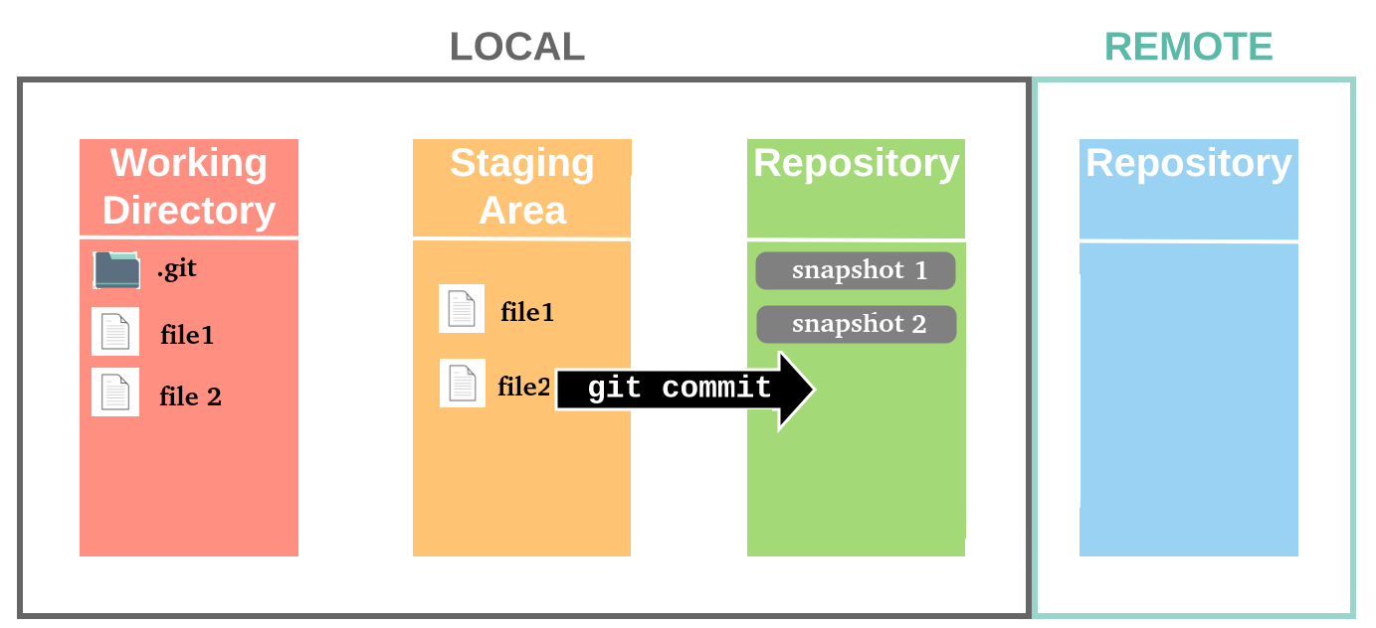

Slide 45
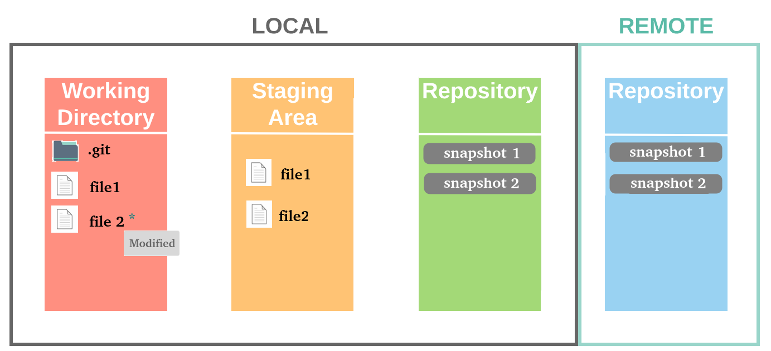
What if you modify a tracked file?

Slide 46
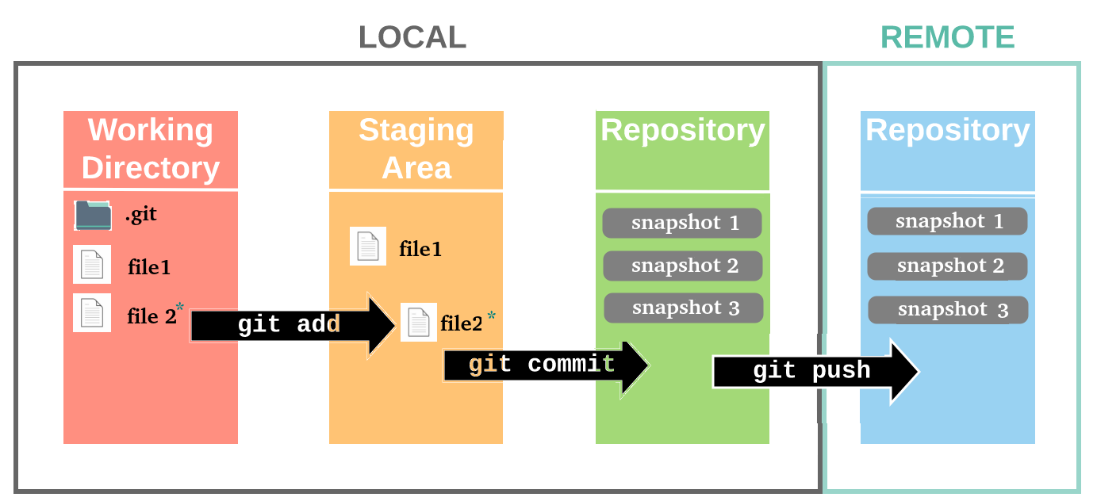

Slide 47
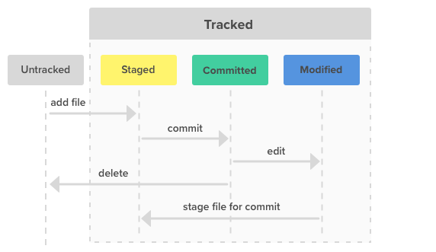
Git Files Status ___________________________________

Slide 48
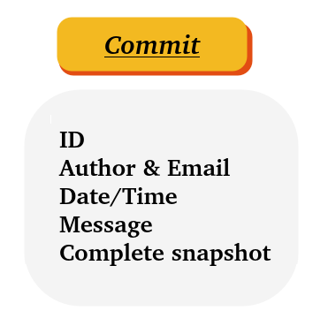
Git Commit ___________________________________

Slide 49
Let’s try it now

Slide 50
Git Common Commands

Slide 51
How to Write Git Commands? ___________________________________
Git commands format is
🡪 git <command> [<args>]
Examples:
git init
git add main.cpp
git commit -m “add main.cpp”

Slide 52
Managing Repository _____________________
add, remove, status, commit, clean

Slide 53
status ___________________________________
Describe what’s going on the repository
Detailed status: status
Brief status: status -s

Slide 54
add ___________________________________
Moves untracked changes to staging area
Add a file/directory: add <filename,dir name>
Add all files: add . or add —all
Add files with patterns: add <pattern>, Ex: git add *.txt: adds all txt files

Slide 55
remove ___________________________________
Removes added files/directories from staging area to untracked
Remove newly added files: rm –cached
Remove newly added directories: rm -r –cached

Slide 56
restore ___________________________________
Moves changes from staging area to untracked
restore file initial state: restore <filename>
move to untracked: restore —staged <filename>

Slide 57
clean ___________________________________
Remove files that are untracked
Removes any files that aren’t in staging area: clean

Slide 58
commit ___________________________________
Takes a snapshot of working directory
Commit with message: commit -m “message”

Slide 59
log ___________________________________
Watch your timeline
Detailed history: log
Brief history: log –oneline
Graph history: log –graph
Git reflog show all flow of commits

Slide 60
diff ___________________________________
View changes in detail
Detailed changes to file: diff <file-name>
Brief changes to file: diff –stat <file-name>
Brief changes to all: diff –stat <commit-code>

Slide 61
amend ___________________________________
Changes last commit
Change message: commit –amend -m “new message”
Change content: commit –amend –no-edit

Slide 62
checkout ___________________________________
Travel through your timeline
One file checkout <filename>
Whole directory: checkout <commit-code>

Slide 63
reset ___________________________________
Travel through the past
Go to previous commit but keep changes reset <commit-code>
Go to previous commit and ignore changes: reset <commit-code> –hard

Slide 64
What’s .gitignore? ___________________________________
A gitignore file specifies intentionally untracked files that Git should ignore.
Files already tracked by Git are not affected

Slide 65
Why .gitignore? ___________________________________
Untracked files aren’t the same, we can split them to two categories:
Files you want to share, you might add to staging area
Files you won’t share, you will never add to staging area → (why should git watch this?) That’s the neet part it shouldn’t

Slide 66
How to .gitignore? ___________________________________
Each line will describe either :
A file name ex: main.cpp
OR
A pattern ex: *.

Slide 67
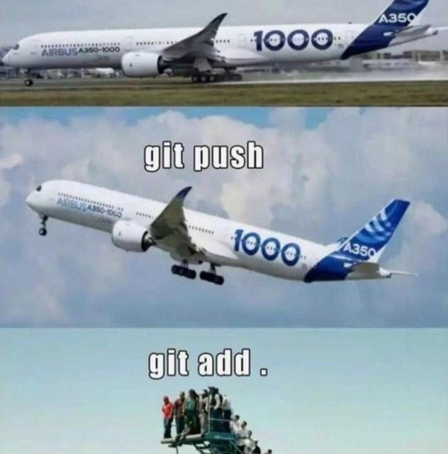
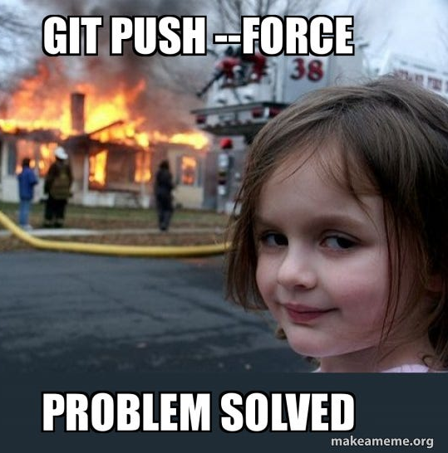

Slide 68

Break

Slide 69
Git Branches

Slide 70
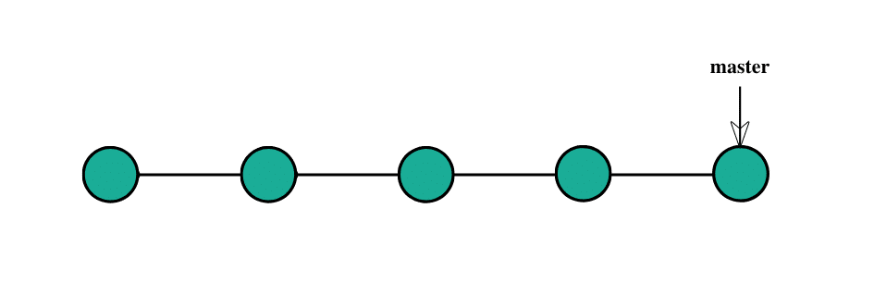
What is a Branch in Git?

Slide 71
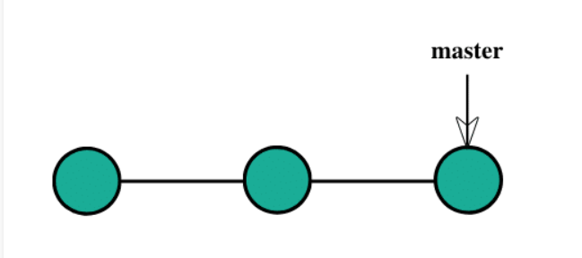
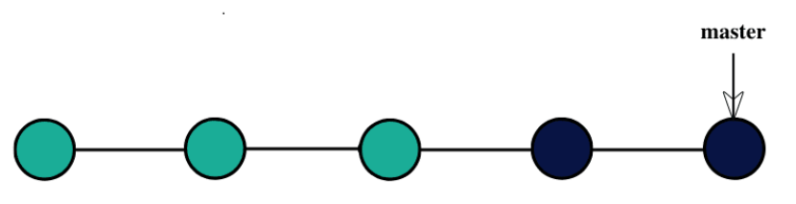
Project Development through linear development

Slide 72
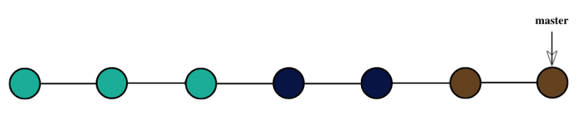
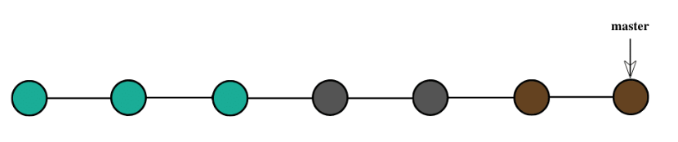
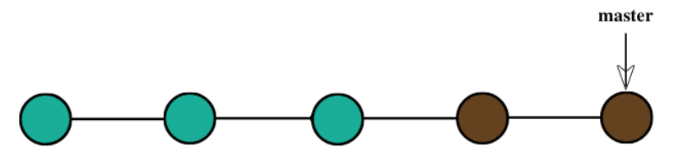

Slide 73
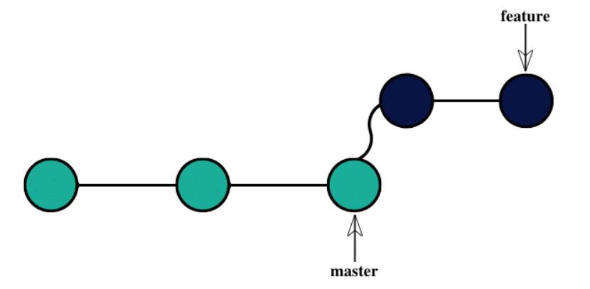
Developing the project through branching

Slide 74
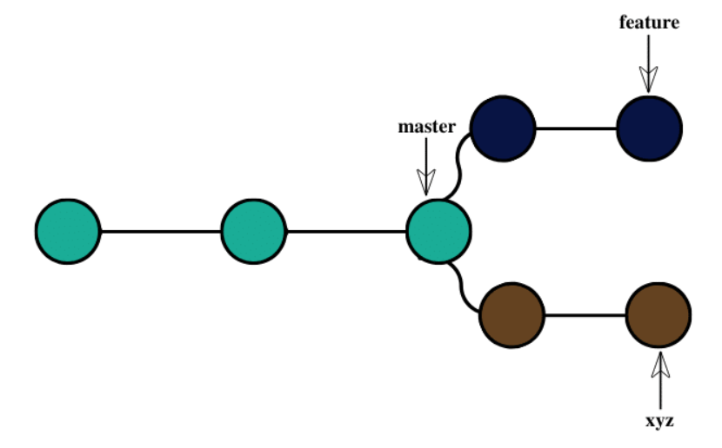

Slide 75
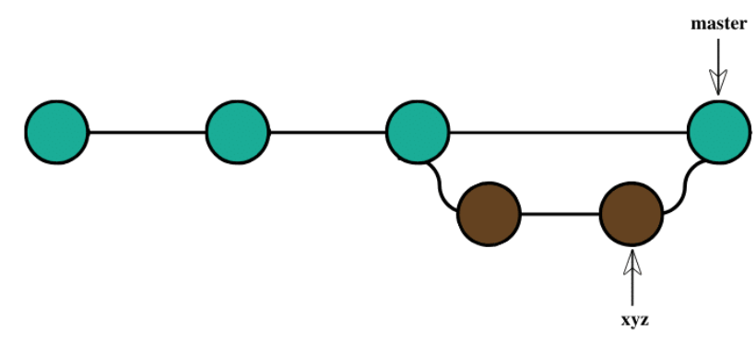

Slide 76
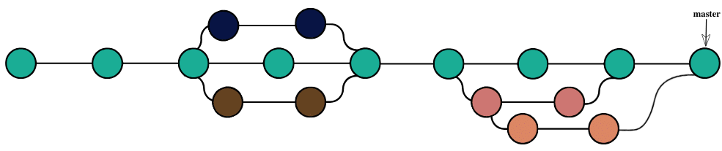

Slide 77
Branches Commands

Slide 78
Let’s try it now

Slide 79
Recap ___________________________________
create : git branch <branch-name>
display: git branch
delete: git branch -d <branch-name>
move: git checkout <branch-name>
rename: git branch -m <branch-name>

Slide 80
Merging
Combining your work

Slide 81
Straight forward ___________________________________
Merge <branch-name>

Slide 82
Resolve Conflict ___________________________________
Merge <branch-name>
If changes wasn’t straight forward git’ll ask you to resolve the changes and create a new commit

Slide 83
Remote Repository _____________________
Sharing your development

Slide 84
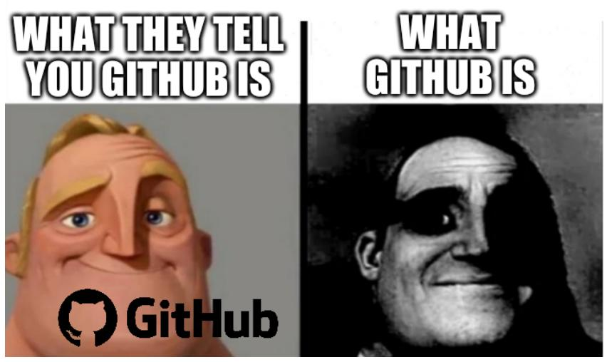
There is more and more

Slide 85
GitHub

Slide 86
The Basic Workflow of Github

Slide 95
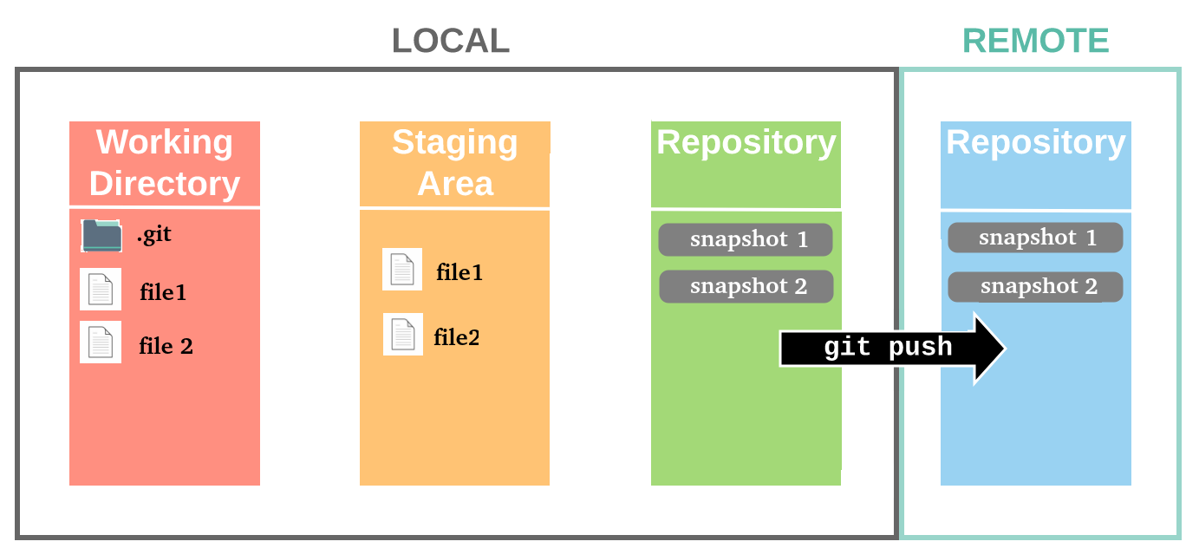

Slide 96
What if you modify a tracked file?

Slide 98
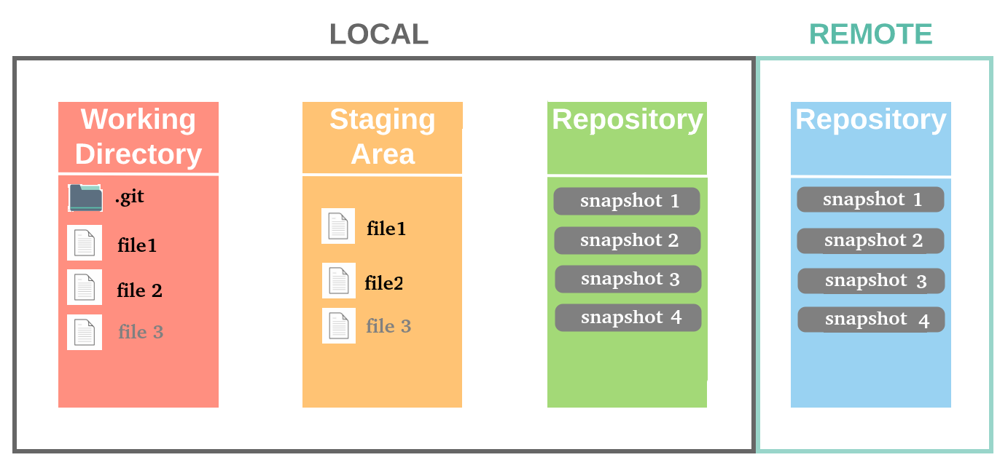
What if your repo is not up-to-date?
Your Friend:

Slide 99
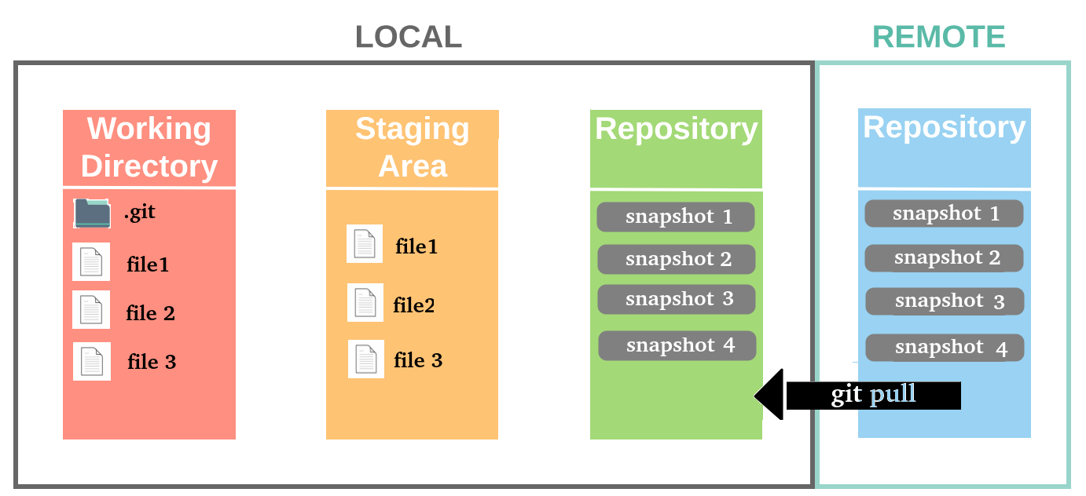

Slide 100
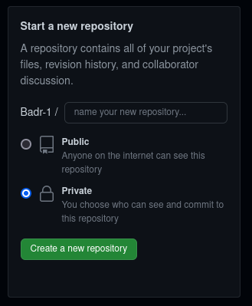
Create a new Repository on GitHub

Slide 101
New Repository ___________________________________
echo "# demo" >> README.md
git init
git add README.md
git commit -m "first commit"
git branch -M main
git remote add origin URL
git push -u origin main

Slide 102
Existing Repository ___________________________________
git remote add origin https://github.com/Badr-1/demo.git
git branch -M main
git push -u origin main

Slide 103
Cloning _____________________
Getting a remote repository to your local repository

Slide 104
Fetching _____________________
Getting a remote repository changes to your local repository

Slide 105
Pulling _____________________
Fetching changing and merging to local repository

Slide 106
Cloning and download _____________________
Getting a remote repository to your local repository

Slide 107
Cloning _____________________
CLONE OUR FIRST SESSION

Slide 108
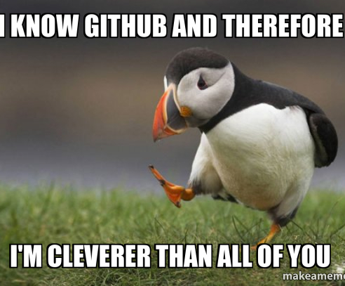
ALL??
Alias commands
What diff HTTPS,SSH
Forking
Contributions
Git internals
Rebasing vs merging
Using GUI
….
….

Slide 109
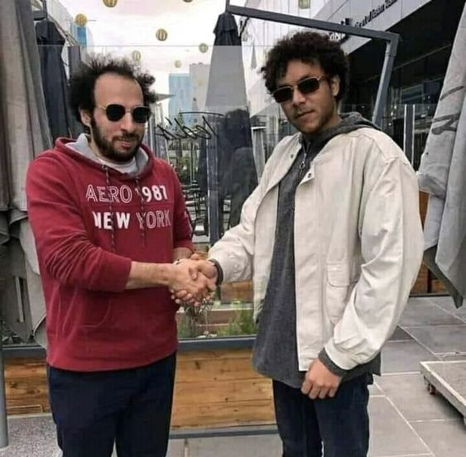
Youtube videos
(133) Free software, free society: Richard Stallman at TEDxGeneva 2014 - YouTube
(133) The mind behind Linux | Linus Torvalds | TED – YouTube
(133) What is Git? (Arabic) – YouTube
(133) Git and GitHub | شخبط وانت متطمن - YouTube
Books
-pro git
-Git Internals by Scott Chacon
To watch
(133) Git Unleashed – YouTube
(133) Git Internals - Intro Video – YouTube
(133) Git for Professionals Tutorial - Tools & Concepts for Mastering Version Control with Git - YouTube

Slide 110

OSC-Open Source Community

